Slide 1
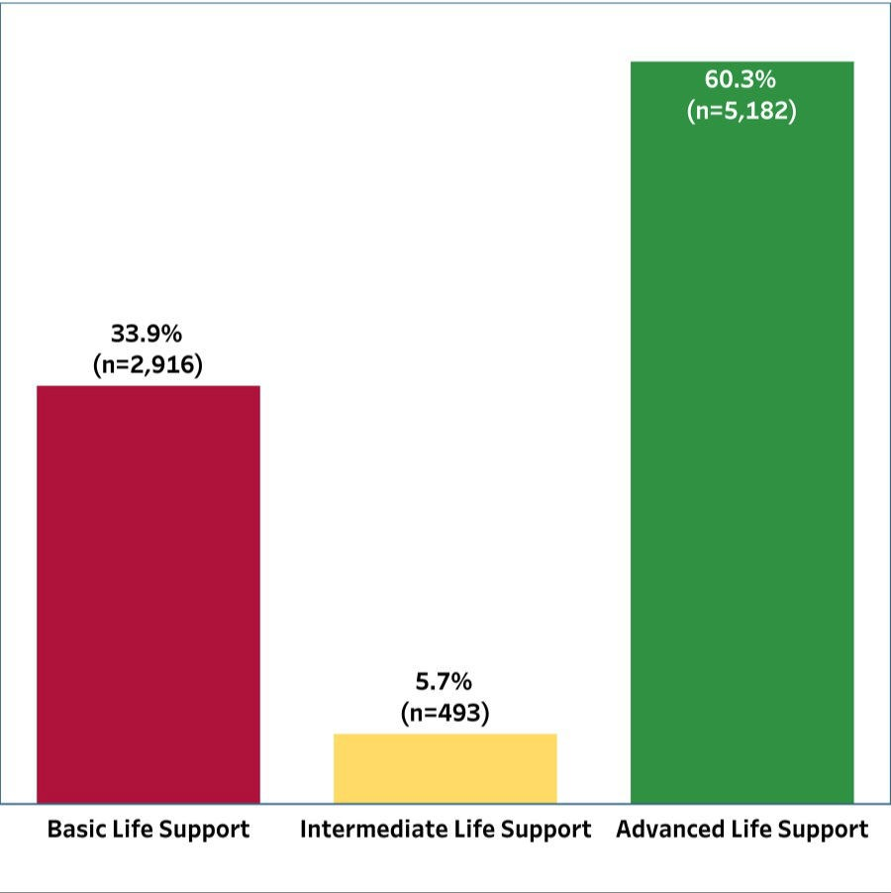
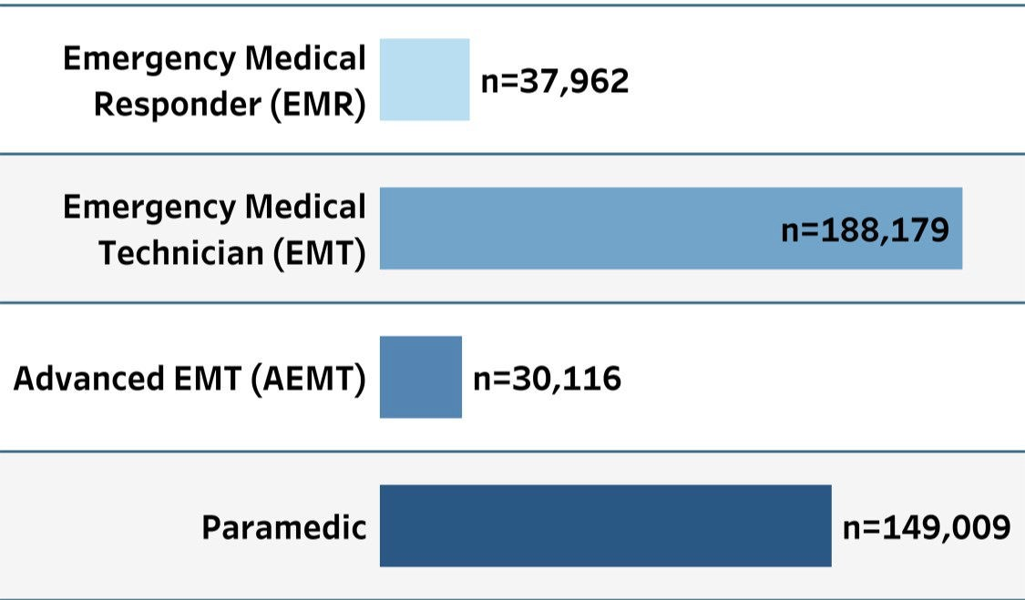
20XX [insert state] EMS for Children Survey Results
XXX EMS
agencies sent survey
To better understand the EMS system’s ability to care for pediatric patients, the [insert state] EMS for Children Program conducted a survey of EMS agencies. The following are the results of this quality improvement effort. EMS agencies can learn more about their state efforts by contacting their state EMS for Children Program Manager shown in the Resources sections of this 3-page report.
XXX EMS
agencies
public 911 transporting & NON-transporting EMS agencies
Insert your state shape here
From across the state
Agencies by Highest Licensure
Type of Providers Reported
Insert your graph here from Tableau
Insert your graph here from Tableau
Pediatric Call Volume by Number and % of Agencies
Insert your table here from Tableau
Notes:
This is a similar report to that released after the 2021 EDC virtual workshop. A video showing how to update and edit the document with your state-specific data can be found on the EDC YouTube at https://youtu.be/vrJCUnH5qEc. The video shows how to update in MS Publisher, however in response to requests we converted the document to PowerPoint. The video will still be relevant and will help you update this document.
Look at changing the color scheme (Design, drop down by variants, select new scheme, then manually update colors)

Slide 2
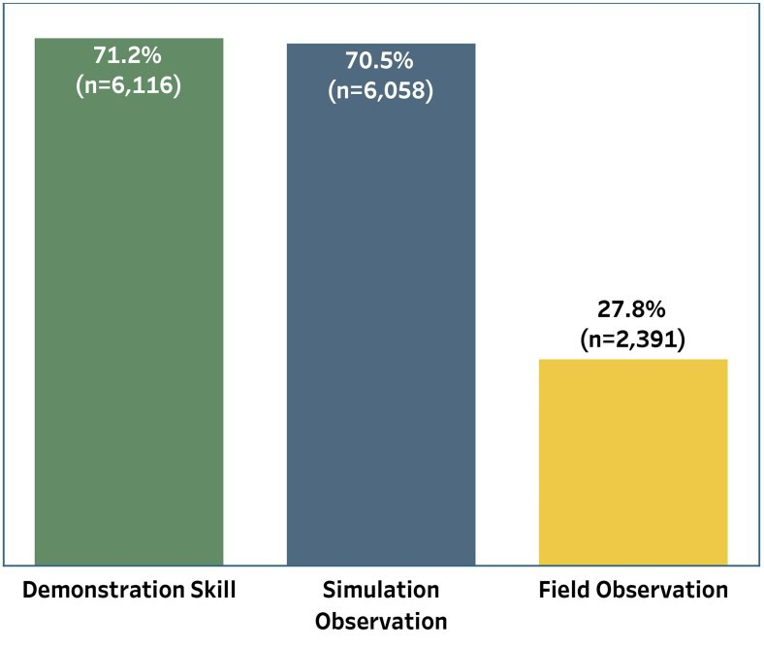
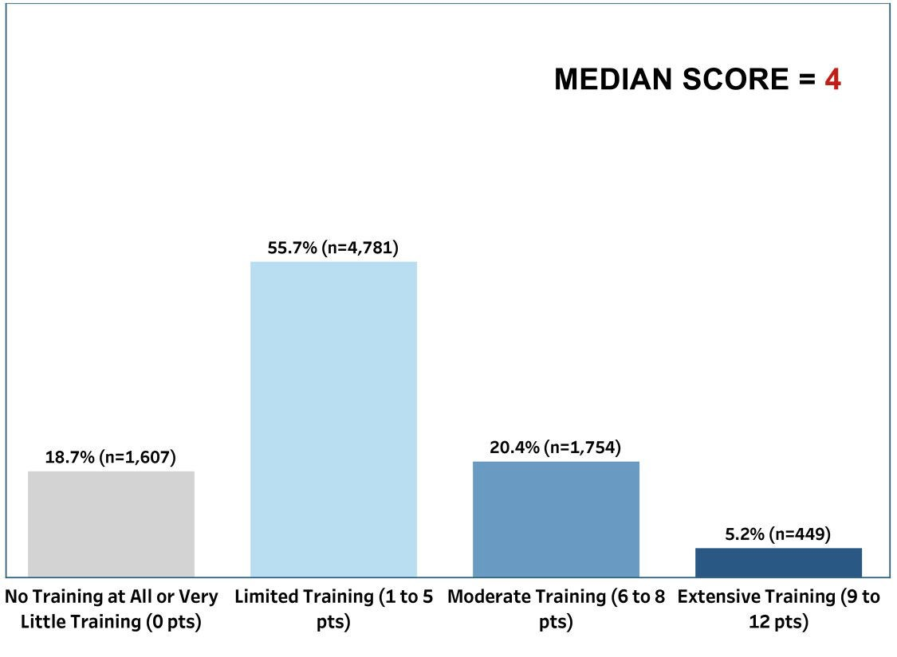
20XX [insert state] EMS for Children Survey Results
XXX EMS
agencies sent survey
To better understand the EMS system’s ability to care for pediatric patients, the [insert state] EMS for Children Program conducted a survey of EMS agencies. The following are the results of this quality improvement effort. EMS agencies can learn more about their state efforts by contacting their state EMS for Children Program Manager shown in the Resources sections of this 3-page report.
Types of Methods for Physically Demonstrating Correct Use of
PEDIATRIC-SPECIFIC Equipment
Simulation Observation
Demonstration Field Observation
Use of Pediatric-Specific Equipment Results
Percent & Type/Method Skill Frequency of Skill-Checking
Insert your graph here from Tableau
Insert your graph here from Tableau
Significance
The processes & frequency of skill-checking evaluations for EMS providers has long been established as important for the maintenance of skills when treating patients for improved patient outcomes.¹⁻³
Miller's Model of Clinical Competence provides a framework for clinical evaluation that theorizes that competency for clinical skills can be demonstrated for EMS through a combination of skill stations, case scenarios & simulations, & real-life field observations with a frequency of at least twice a year.³⁻⁴
Lammers, R. L., Byrwa, M. J., Fales, W. D., & Hale, R. A. (2009). S im ulati on -based A ssessme n t of
Pa ra medic Ped iatr ic Resu scitati on S k ill s . Prehospital Emergency Care, 13(3), 345–356.
Su, E., Schmidt, T. A., Mann, N. C., & Zechnich, A. D. (2000). A Ra nd om ized C on tro lled Tria l t o
Assess Dec ay in Acq uire d Kn ow led ge A mo ng P ar amedics C omp letin g a Pe diatr ic Res uscita tio n
C ourse . Academic Emergency Medicine, 7(7), 779-786.
Miller GE. T he Assess ment o f C l inica l S k il ls/C o mpetence /P er f orma nce . Acad Med 1990; 65:S63- 67.
National EMS for Children Data Analysis Resource Center (NEDARC). EMS f or C h ildre n
Pe rformance Mea sure s : I m pleme ntati on Man ual for S tate Pa rtner s hip Gra ntees . Salt Lake City, UT: NEDARC; 2017.
Click h er e and go to page 35 to see how the skill-checking points were
Resources
Pediatric Readiness in EMS Systems
Joint Policy Statement
Technical Report
Prehospital Pediatric Readiness
Toolkit (Education and Competencies for Providers)
Checklist
Pediatric Education and Advocacy Kits (PEAK)
Use of Pediatric-Specific Equipment (video)
Your [state] EMS for Children Program Manager: [insert name, phone, email]

Slide 3
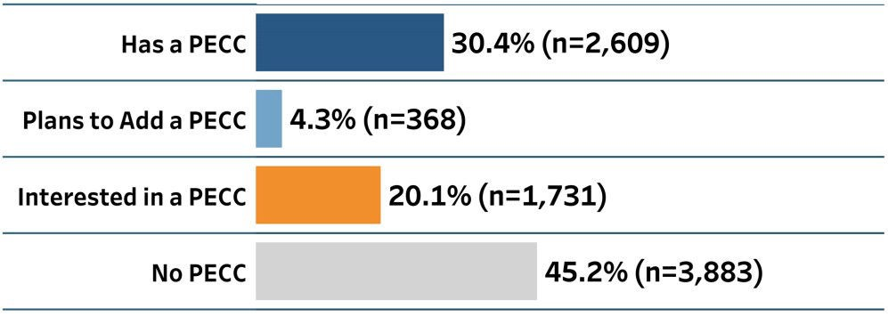
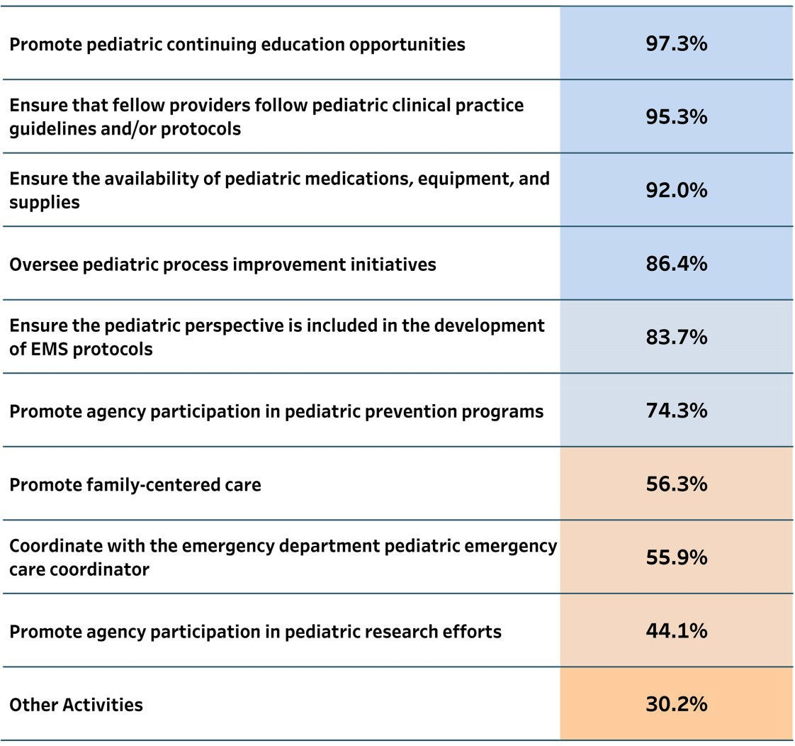
20XX [insert state] EMS for Children Survey Results
XXX EMS
agencies sent survey
To better understand the EMS system’s ability to care for pediatric patients, the [insert state] EMS for Children Program conducted a survey of EMS agencies. The following are the results of this quality improvement effort. EMS agencies can learn more about their state efforts by contacting their state EMS for Children Program Manager shown in the Resources sections of this 3-page report.
Pediatric Emergency Care Coordinator (PECC) Results
What is a PECC?
A designated individual(s), often called a Pediatric Emergency Care Coordinator or PECC, who is responsible for coordinating and championing pediatric-specific activities for an EMS agency. This individual(s) could serve as the PECC for one or more EMS agencies.
PECC at Agencies
Agencies Who Have a PECC
Insert your graph here from Tableau
PECC Oversees
Insert your graph here from Tableau
Insert your table here from Tableau
Significance
A study of the readiness of hospital emergency departments (EDs) to care for children has shown that EDs are more prepared to care for children when there is a PECC who is responsible for championing & making recommendations for policies, training, & resources pertinent to the emergency care of children.¹ While this study was conducted in EDs, the 2020 joint policy statement,² Pediatric Readiness in EMS Systems, states the importance of EMS physicians, administrators, & personnel to collaborate with pediatric acute care experts to optimize EMS care for children to improve outcomes. In further support of the importance of EMS agency PECCs, a recent study “found that the availability of a PECC in an agency is associated with increased frequency of pediatric psychomotor skills evaluations.”³
Resources
Pediatric Readiness in EMS Systems
Joint Policy Statement
Technical Report
Prehospital Pediatric Readiness
Toolkit
Checklist
Quality Improvement
Additional PECC Resources
Pediatric Emergency Care Coordinator (video)
Your [state] EMS for Children Program Manager: [insert name, phone, email]
Gausche-Hill, M., Ely, M., Schmuhl, P., Telford, R., Remick, K. E., Edgerton, E. A., & Olson, L. M. (2015). A Na ti ona l As sessme nt of Pe diatr ic Re adines s o f Emerge ncy Depar tme nts . JAMA Pediatrics, 169(6), 527–534.
Moore, B., Shah, M. I., Owusu-Ansah, S., Gross, T., Brown, K., Gausche-Hill, M., Remick, K., Adelgais, K., Lyng, J., Rappaport, L., & Snow, S. (2020). Pe d iatr ic Rea di ness in Emer genc y Me dica l
S er vice s S y stems . Prehospital Emergency Care, 24(2), 175-179.
Hewes, H. A., Ely, M., Richards, R., Shah, M. I., Busch, S., Pilkey, D., Dixon Hert, K., & Olson, L. M. (2018). R ea d y for C hi ldre n : A ssess in g Pe d iatr ic C ar e Coor dina tio n an d Ps ych omo tor S k i lls
Eval uatio n in t he Pre h os pita l S ettin g . Prehospital Emergency Care, DOI:

Slide 4
Puerto Rico
American Samoa
Mariana Islands
Virgin Islands
Guam

